Slide 1
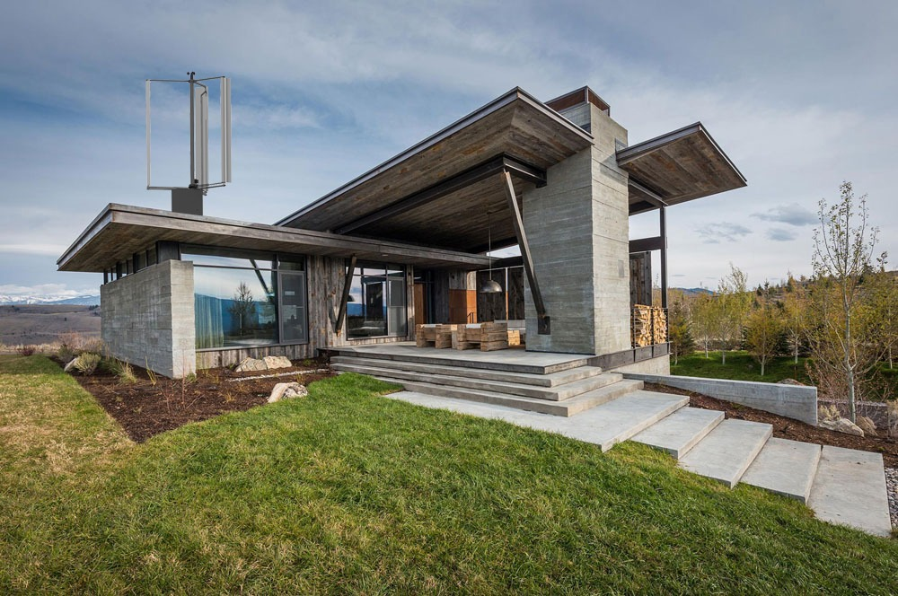

Grupo 3 Gerador Eólico Ponto de Controle 3
Éolo Energy

Slide 2
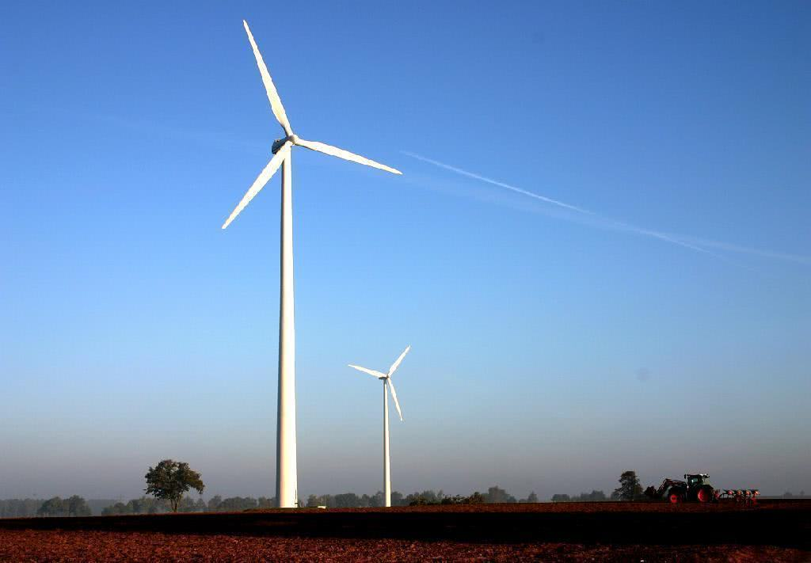
Éolo, superioridade nos ventos.

Slide 3
01
03
Sumário
02
04
Operação do Equipamento
Dados do produto
Especificações Técnicas • Funcionalidades • Integração
Inicialização & utilização;
Integração
Valores Orçados
Integração dos componentes dos subsistemas

Slide 4
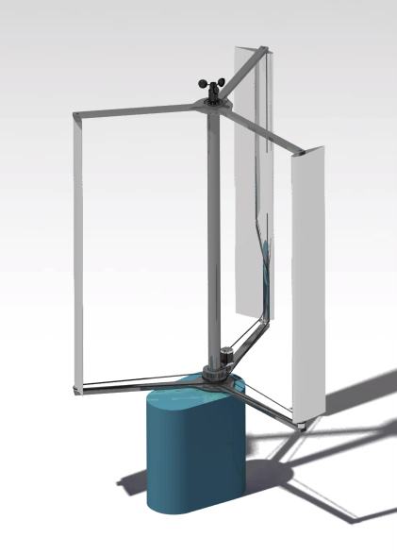
01
Dados do produto
Especificações Técnicas • Funcionalidades • Integração

Slide 5
Especificações técnicas
Dimensões
Potência de Geração
Diâmetro: 1,8 m
Altura: 2,30 m
Peso: 150 kg
Número de pás: 3
Potência nominal: 1500W
Faixa de Operação
Bateria
Modelo: ECO-WORTHY
Tipo: LiFePO4
Capacidade nominal: 20 Ah
Peso: 2 kg
Voltagem: 12 V
Velocidade de partida:
4 m/s
Velocidade do vento nominal: 12 m/s
Velocidade do vento
crítica: 20 m/s

Slide 6
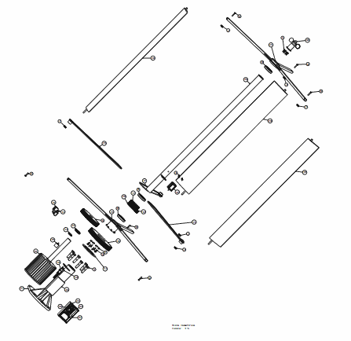
02
Integração
Integração dos sistemas

Slide 7
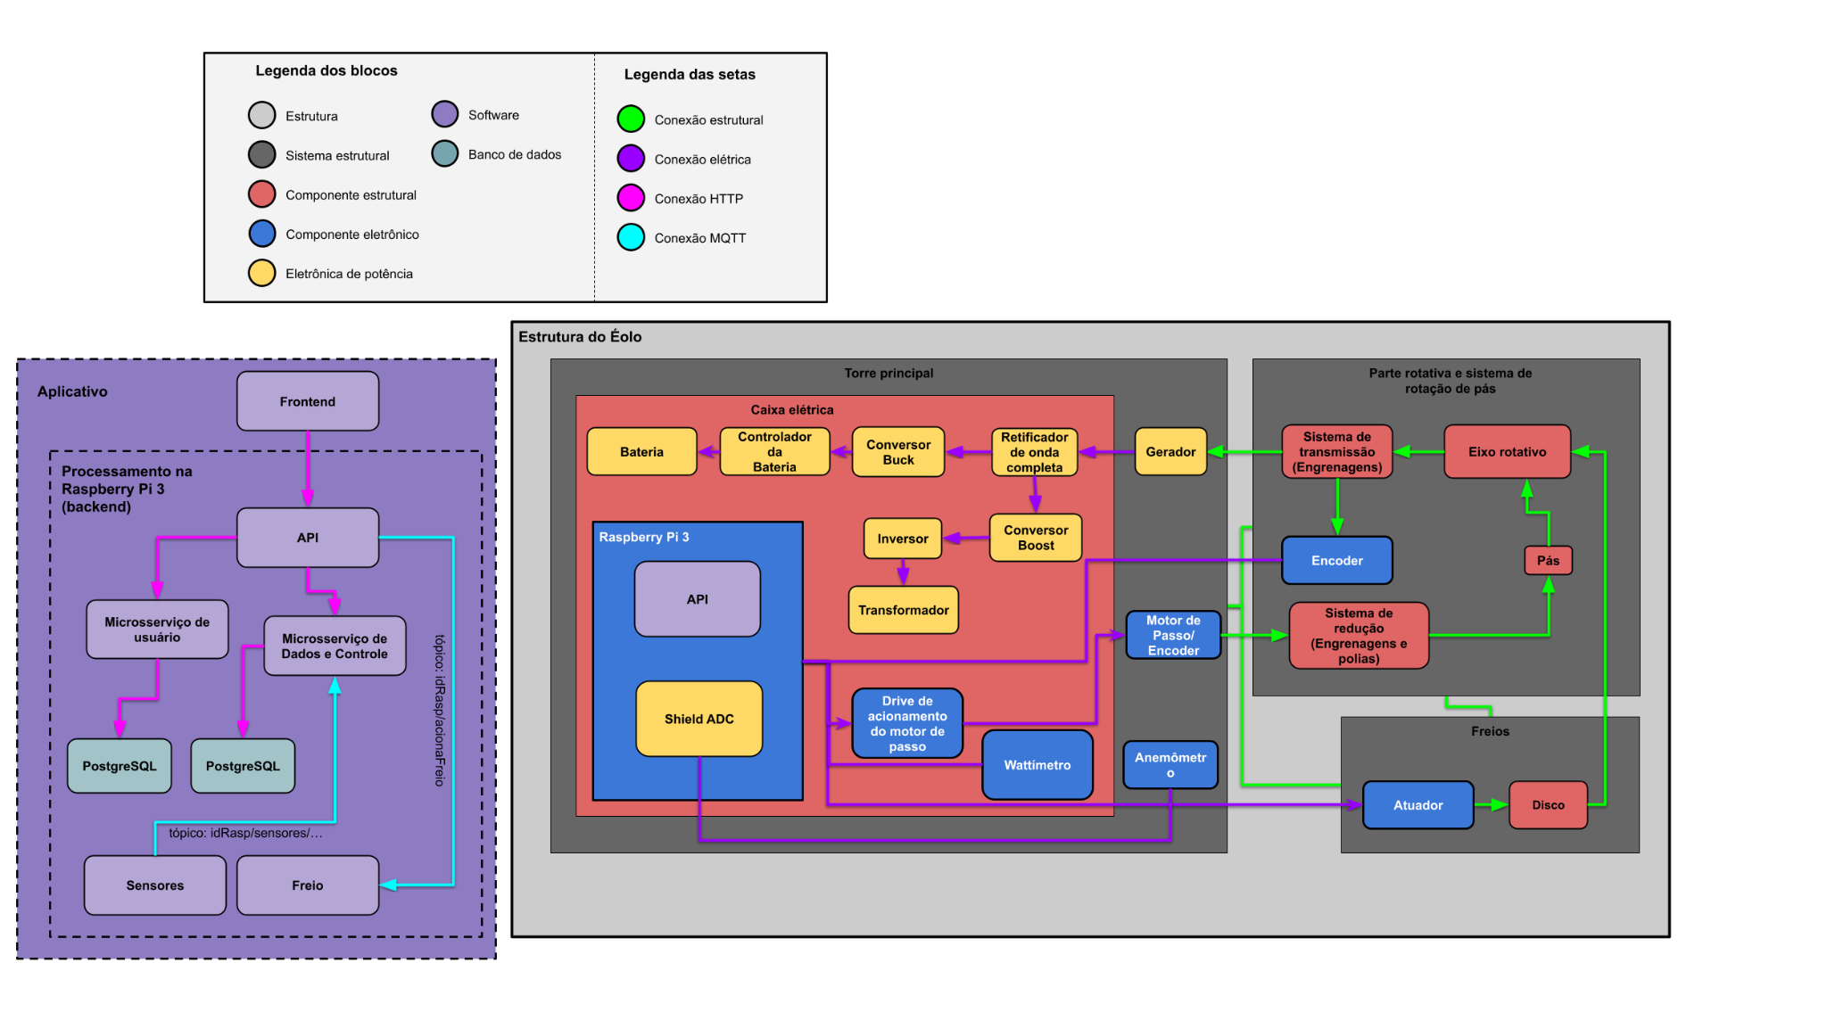
Diagrama de integração

Slide 8
Diagrama de integração – Torre principal

Slide 9
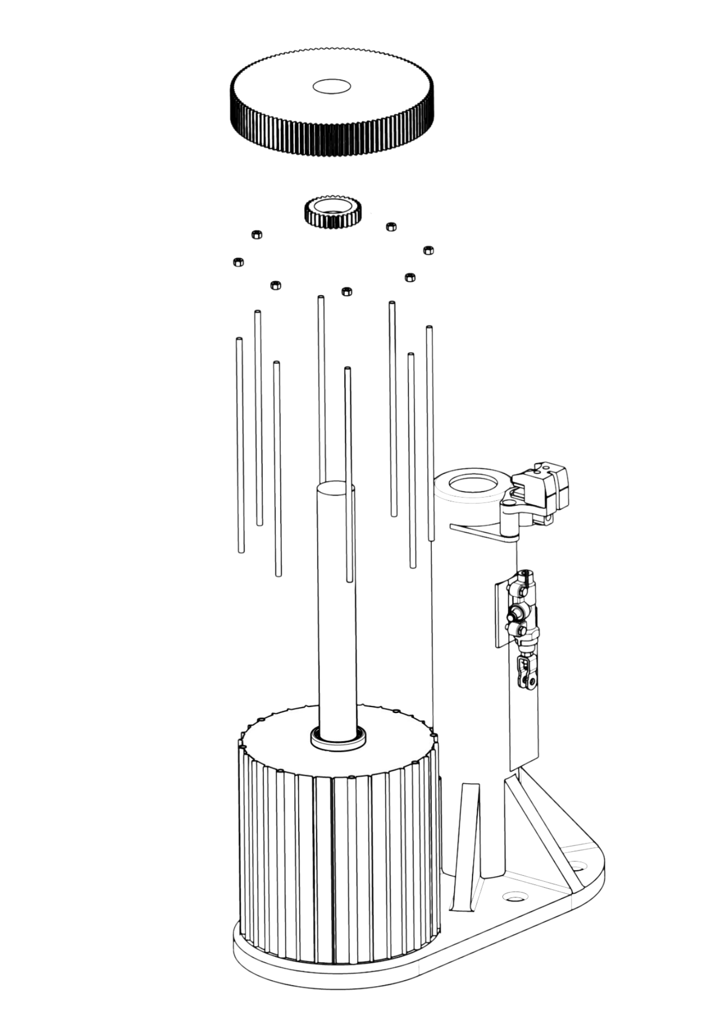
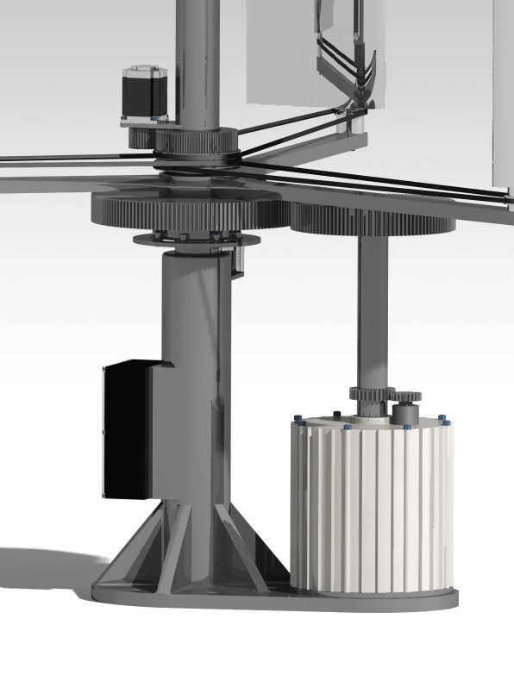
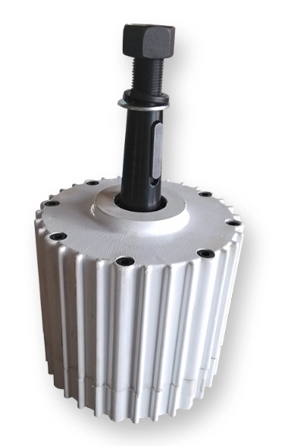
Diagrama de integração – Torre Principal - Gerador
AC Síncrono 1500W Gerador
Gerador

Slide 10
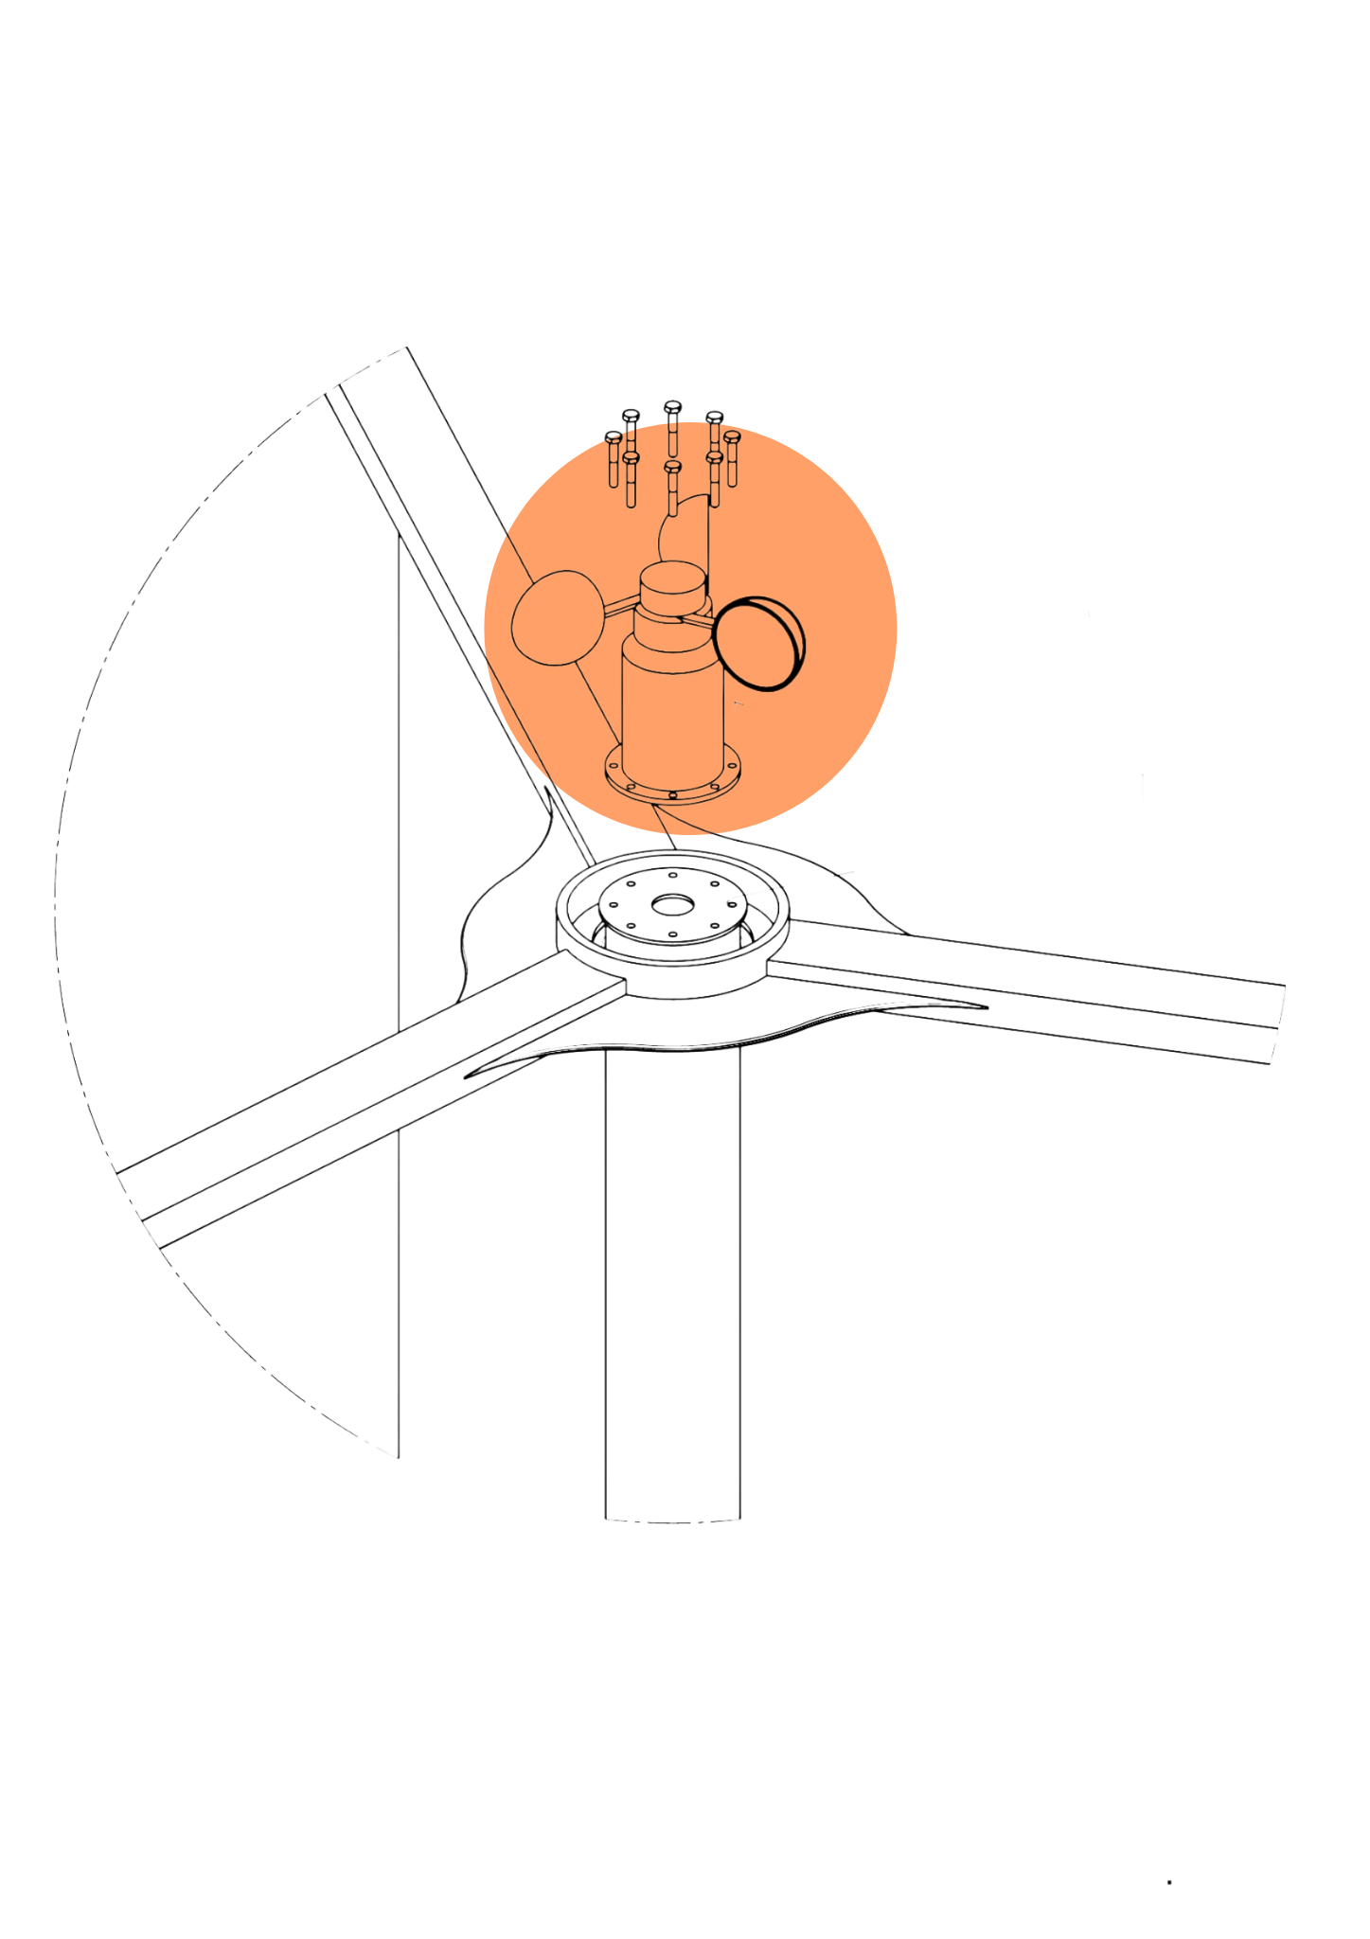
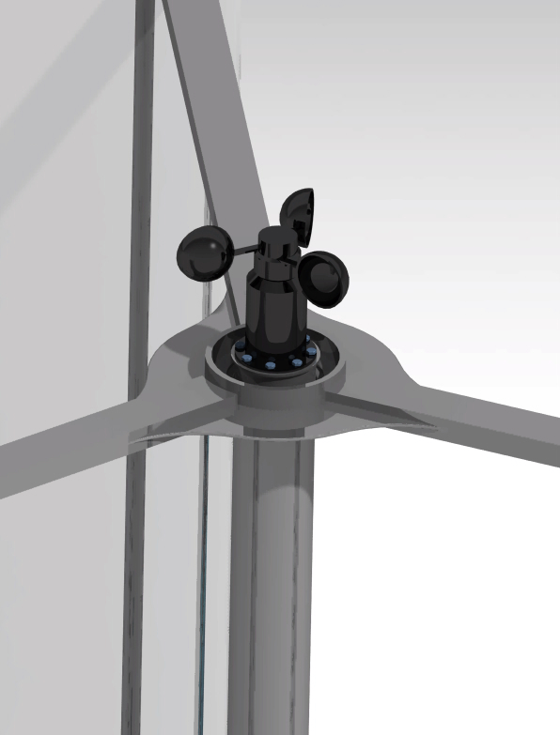
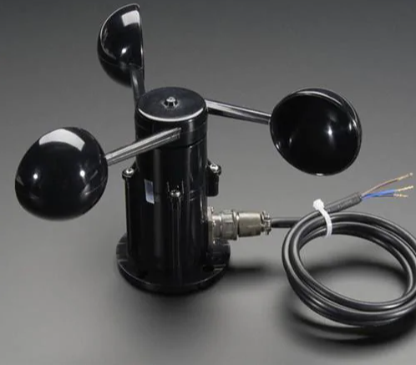
Diagrama de integração – Torre Principal - Anemômetro
Componente Eletrônico
Anemômetro
Adafruit 1733 – Anemômetro

Slide 11
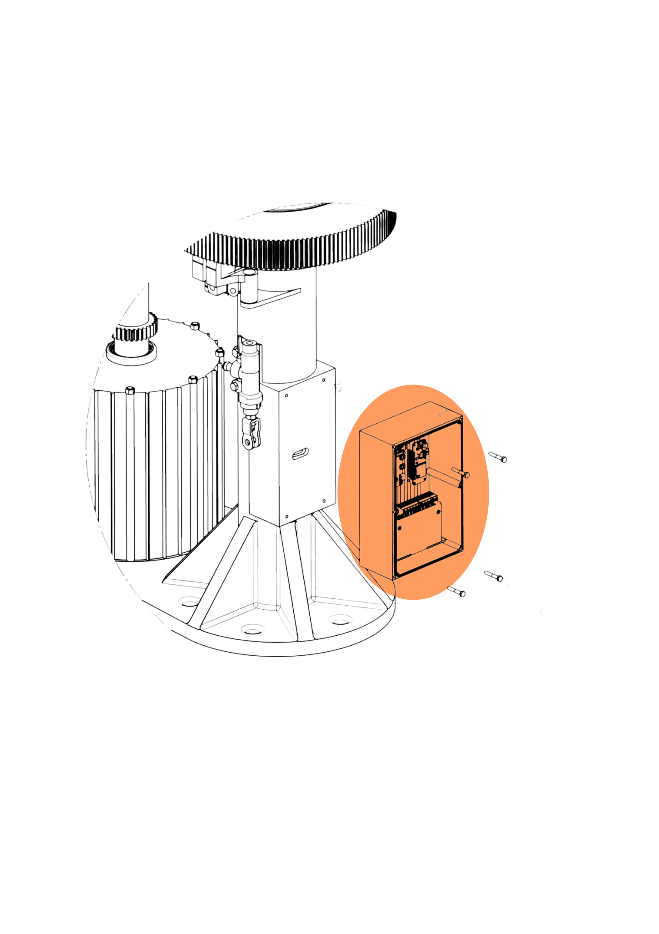
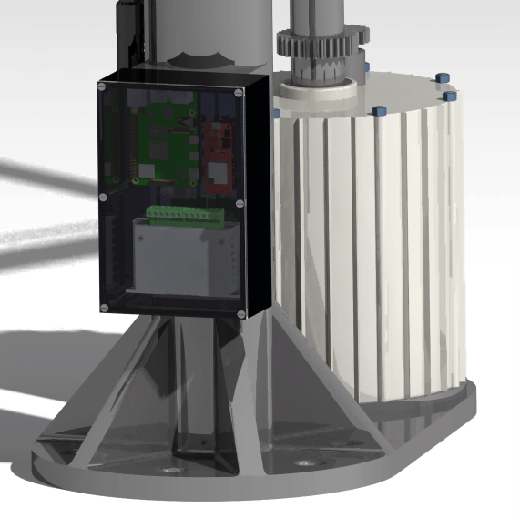
Diagrama de integração – Torre Principal - Caixa Elétrica
Componente Eletrônico
Caixa Elétrica

Slide 12

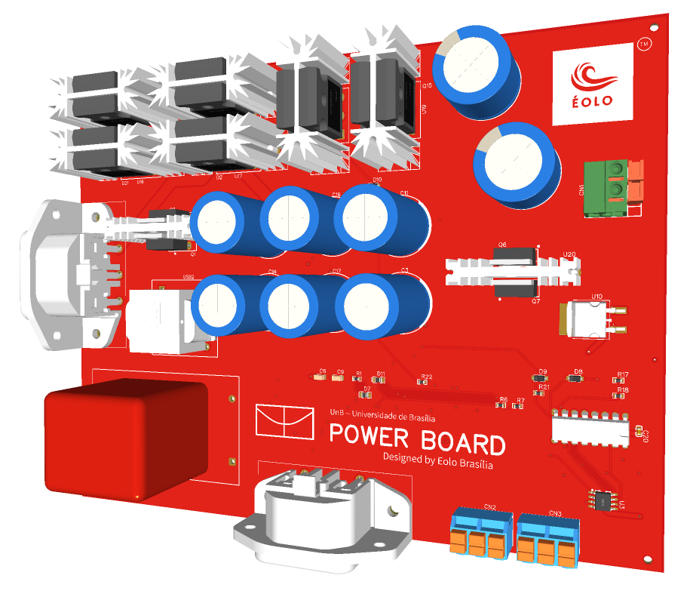
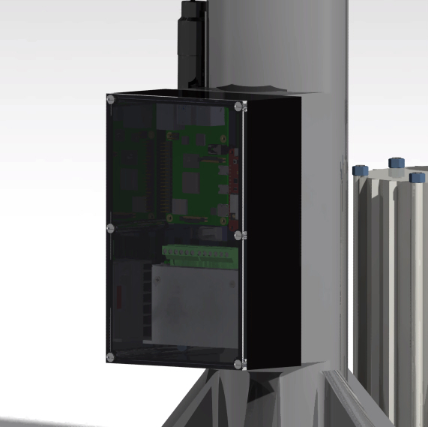
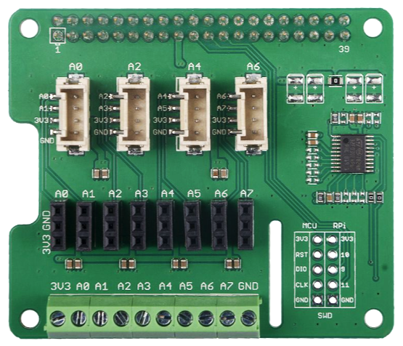

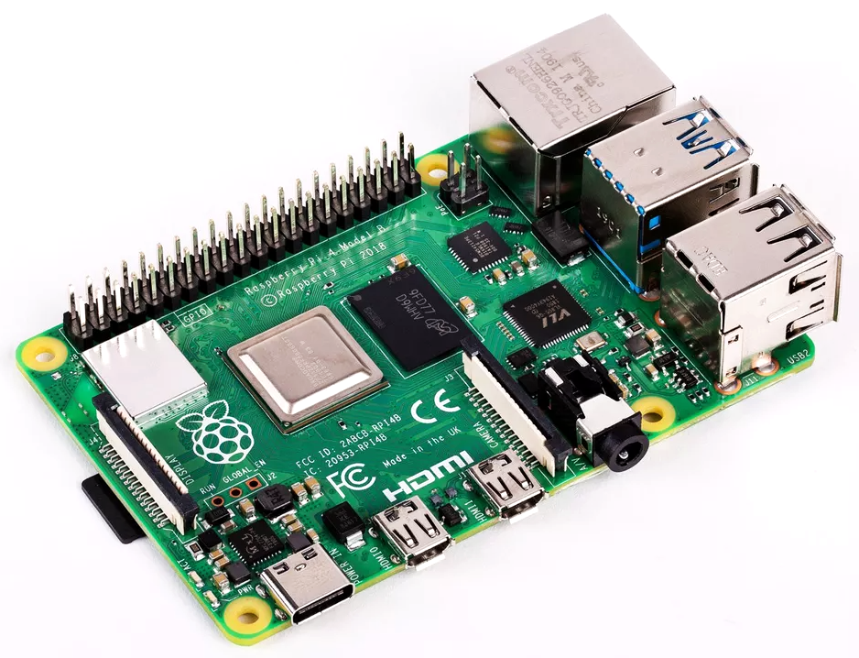
Diagrama de integração – Torre Principal - Caixa Elétrica
Placa de Potência - Desenvolvida
Wattímetro
Shield ADC - Raspberry
Driver Motor de Passo - TB6600
Raspberry Pi 3B

Slide 13
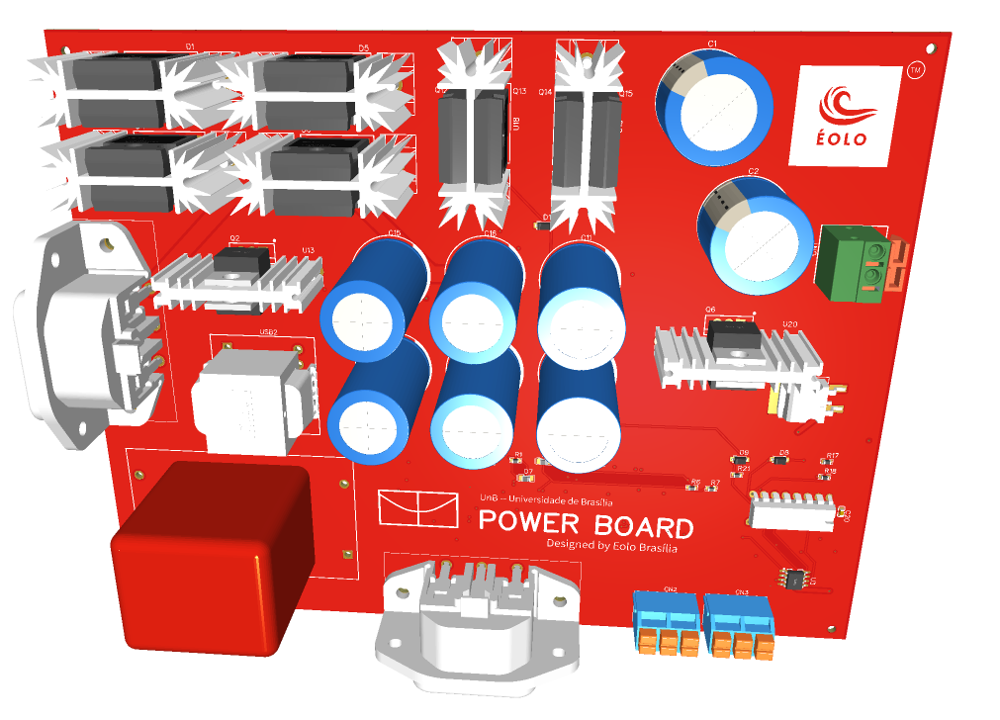
Diagrama de integração – Torre Principal - Caixa Elétrica - Placa de Potência

Slide 14
Diagrama de integração – Rotor & Freio

Slide 15
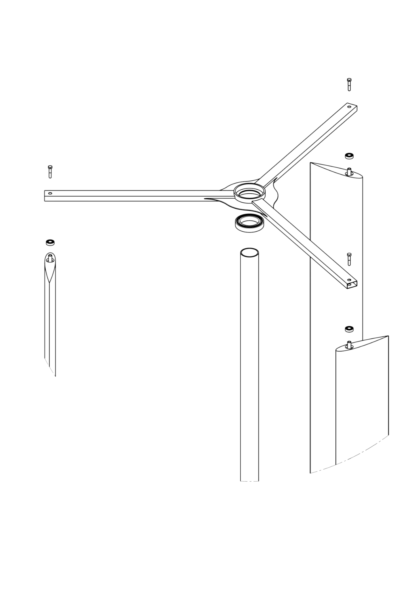
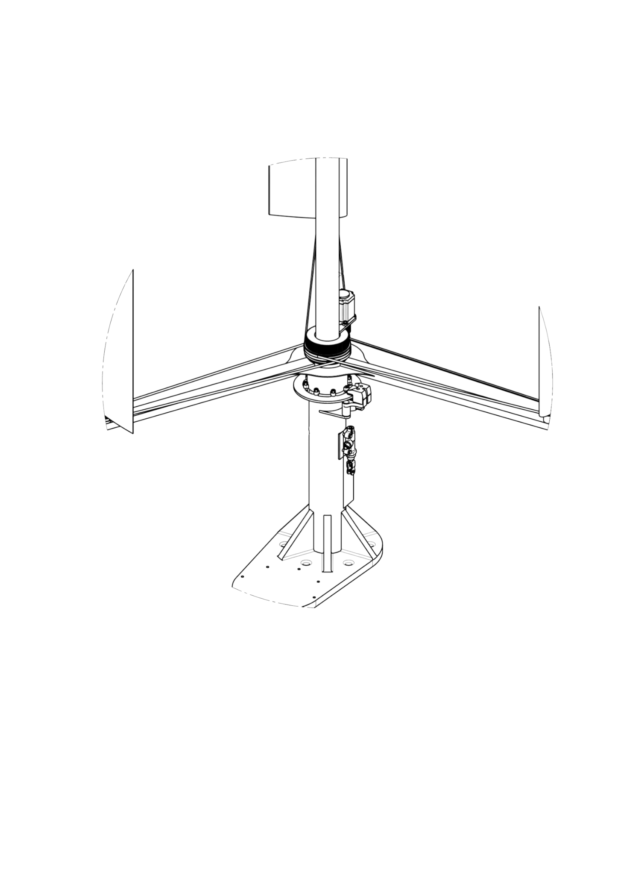
Diagrama de integração – Sistema Rotativo
Rotor Superior
Rotor Inferior

Slide 16
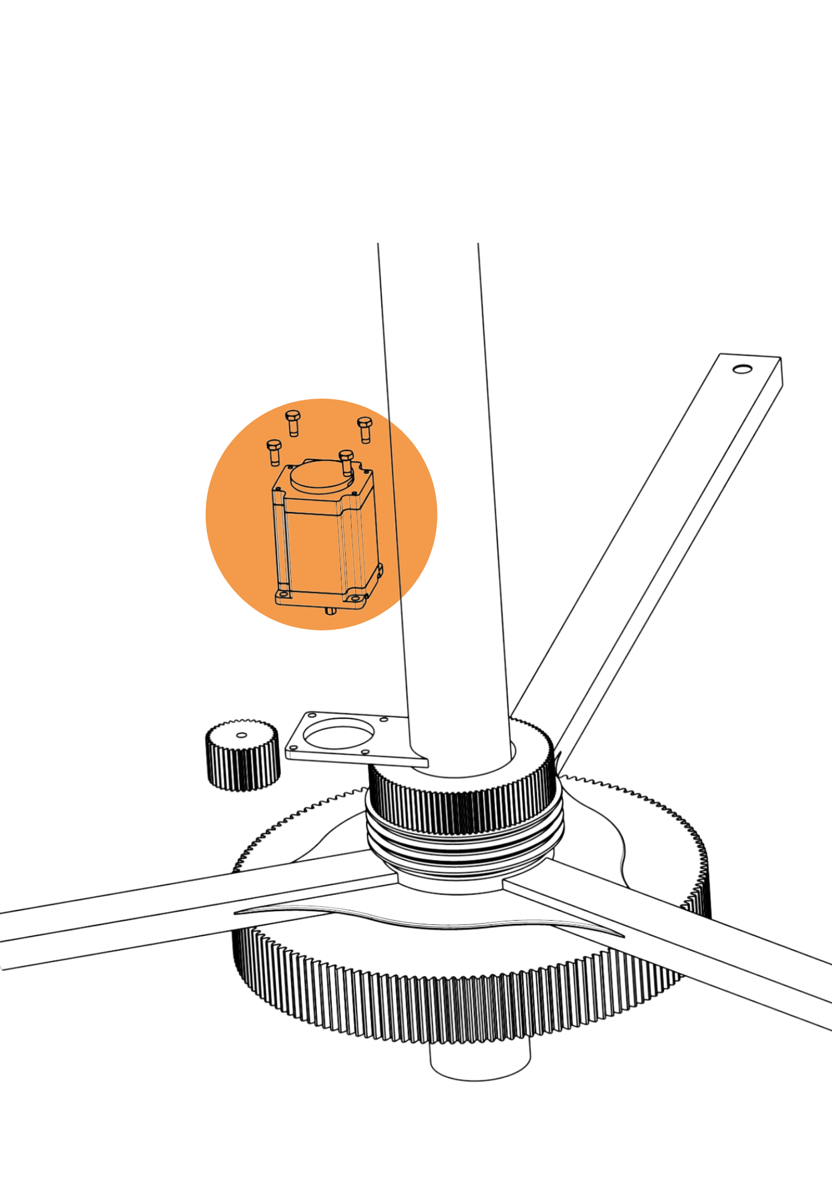

Diagrama de integração – Sistema Rotativo - Motor de Passo
Componente Eletrônico
Motor de Passo
Nema 23 - Motor de Passo

Slide 17
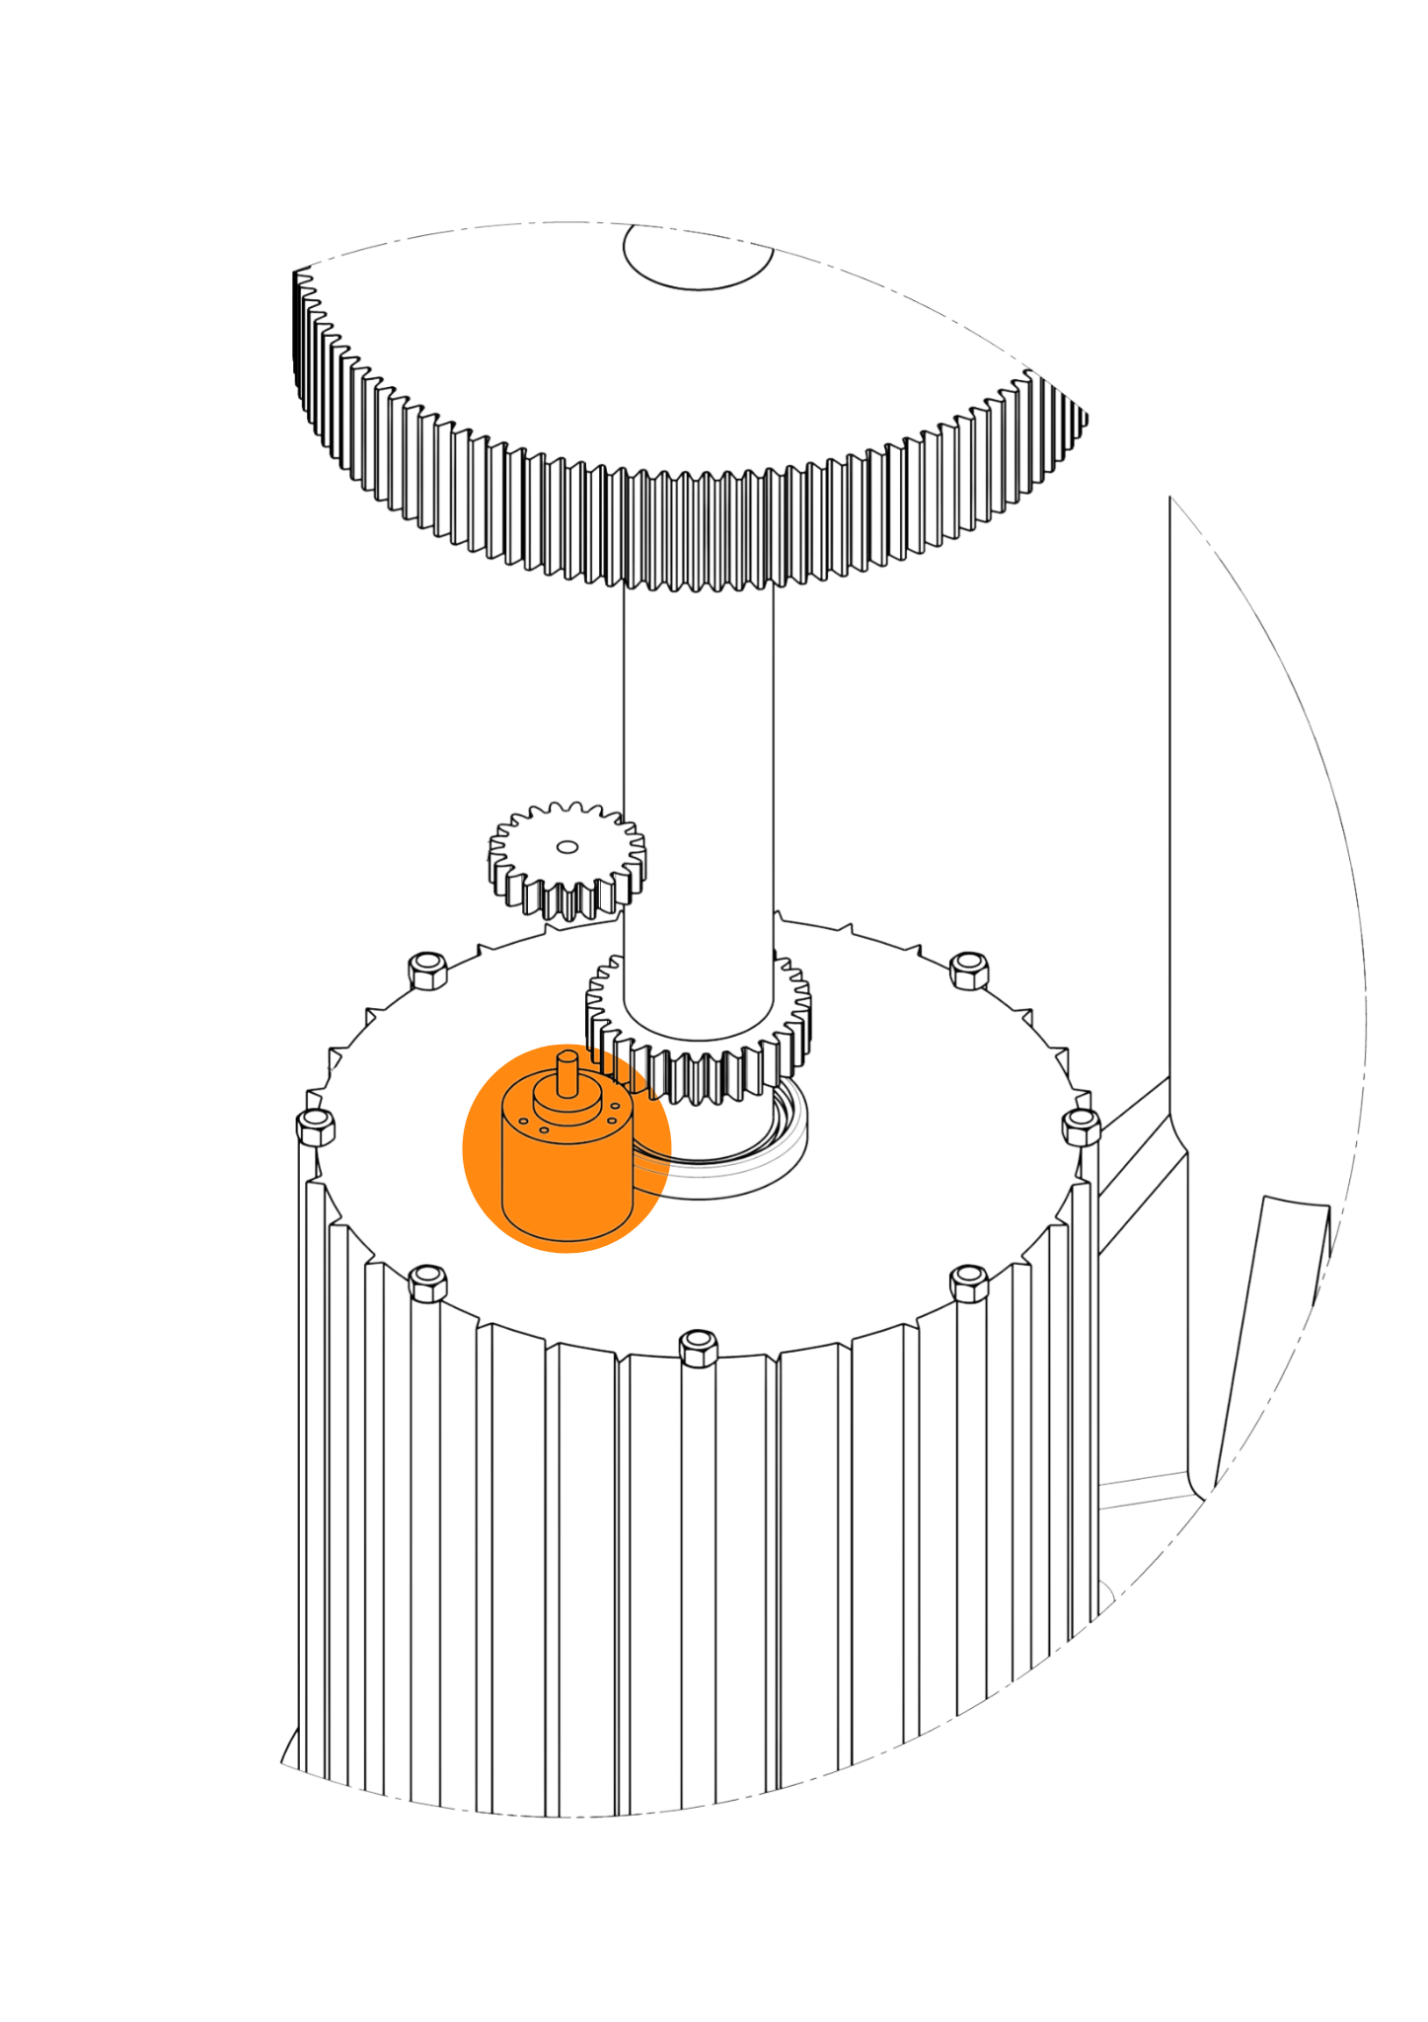

Diagrama de integração – Sistema Rotativo - Encoder
Componente Eletrônico
Encoder
Encoder Incremental Rotativo 600 Pulsos

Slide 18
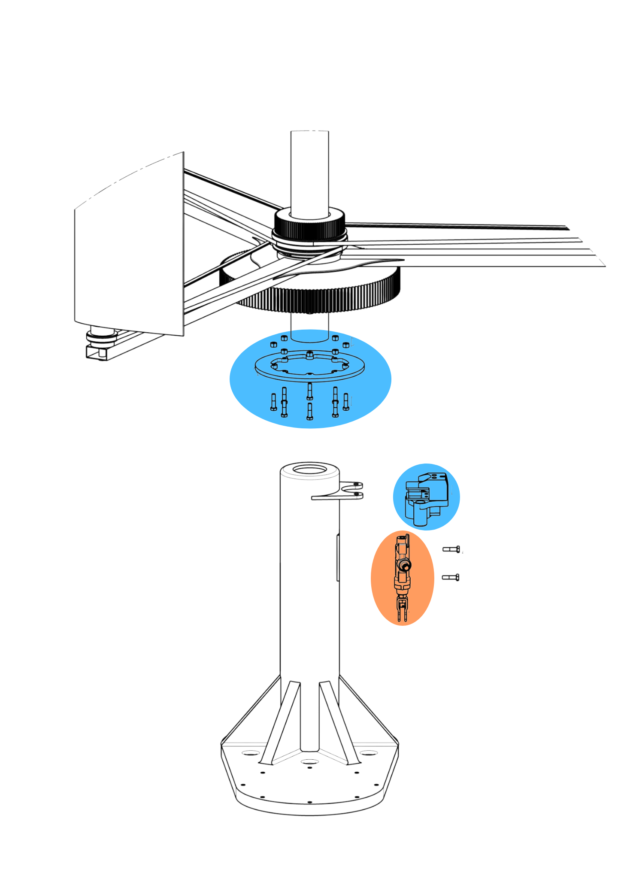
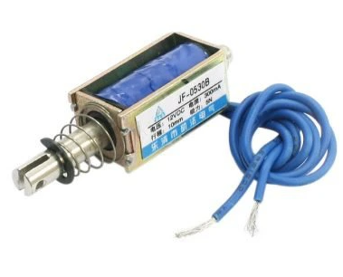
Diagrama de integração – Freio & Solenoide
Disco de Freio
Pinça de Freio
Componente Estrutural
Componente Eletrônico
Solenoide

Slide 19
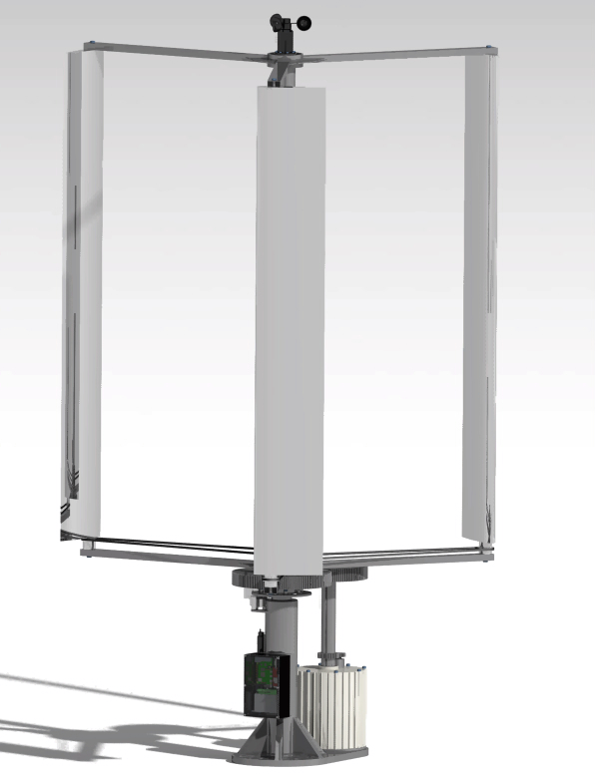
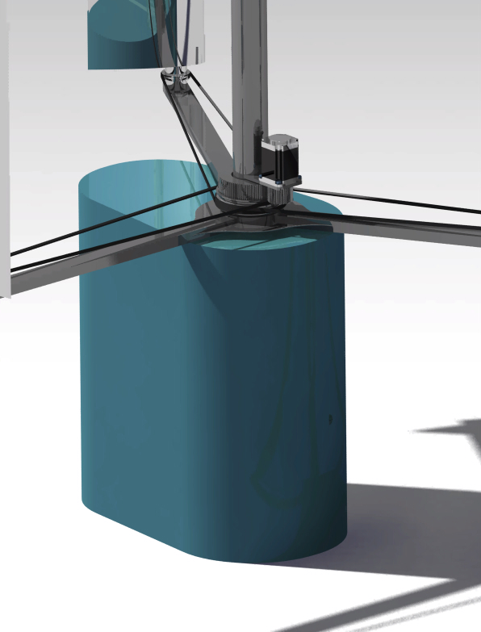
Diagrama de integração – Sistema Rotativo
Case Inferior de Proteção

Slide 20
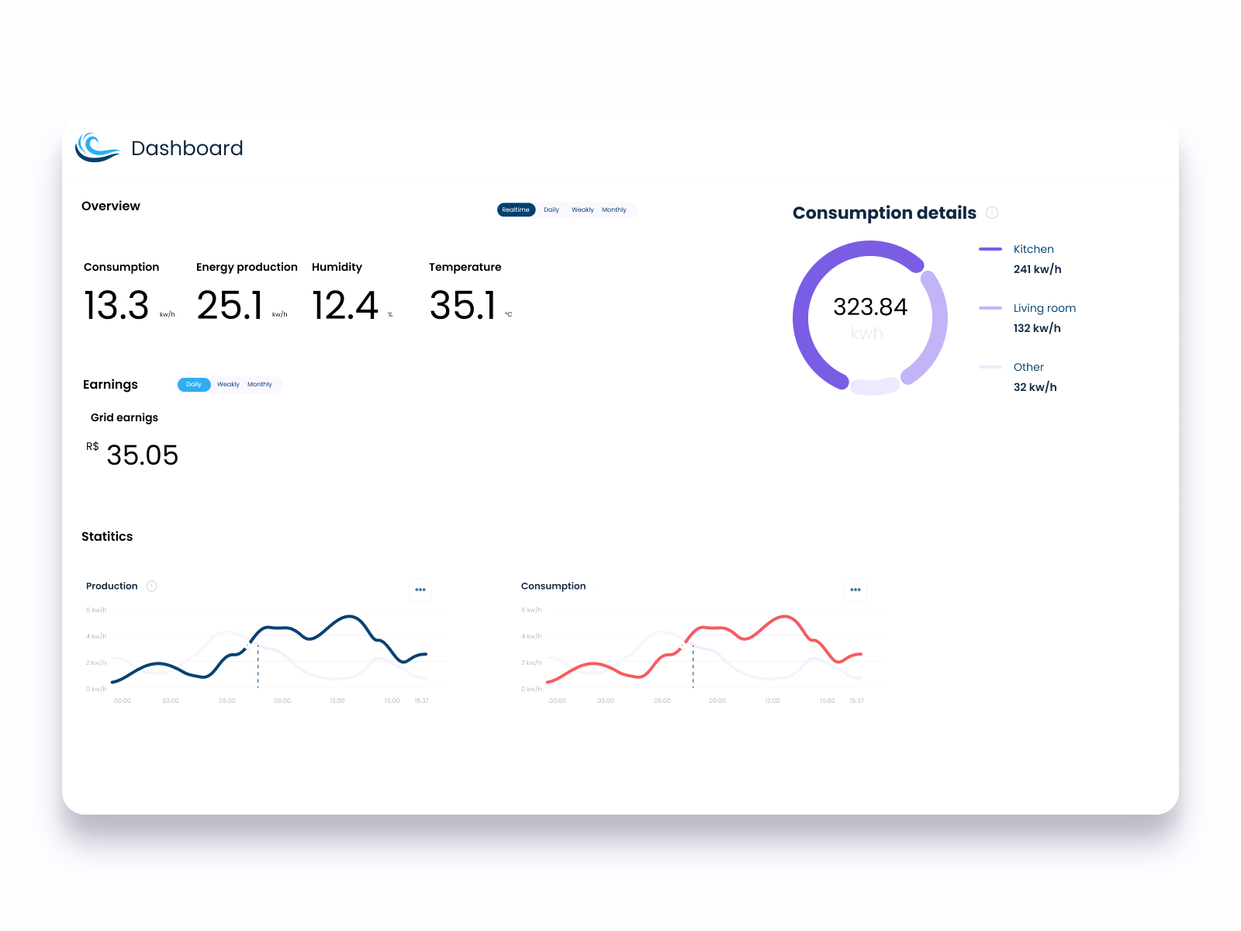
Operação do equipamento
03
Inicialização & utilização;

Slide 21
Diagrama de integração – Aplicativo

Slide 22
Central de Controle
Operação do sistema
Acesso
Controle
Monitoração
O acesso é disponibilizado na rede local
Permite controle parcial do equipamento via interface gráfica
Visualização de dados tanto armazenados como em tempo real

Slide 23
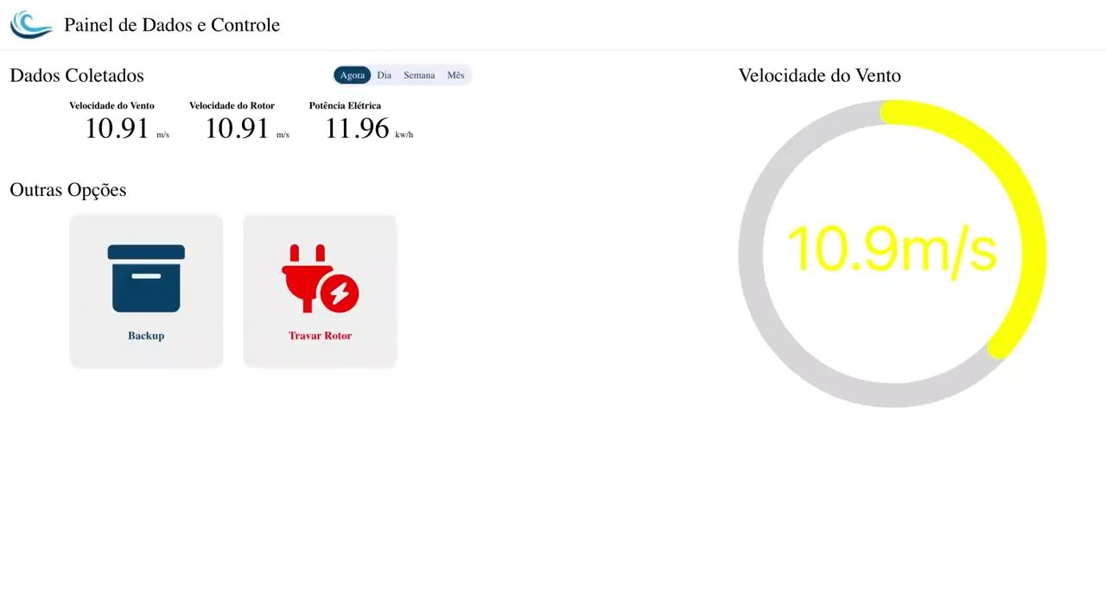
Protótipo desenvolvido

Slide 24
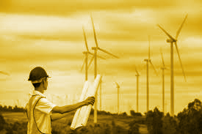
04
Valores Orçados

Slide 25
Orçamento
 | Valor
Estrutura | R$ 4.569,29
Elétrica | R$ 6.228,00
Software | ~R$ 2849,25
Total | R$ 13.646,54

Slide 26
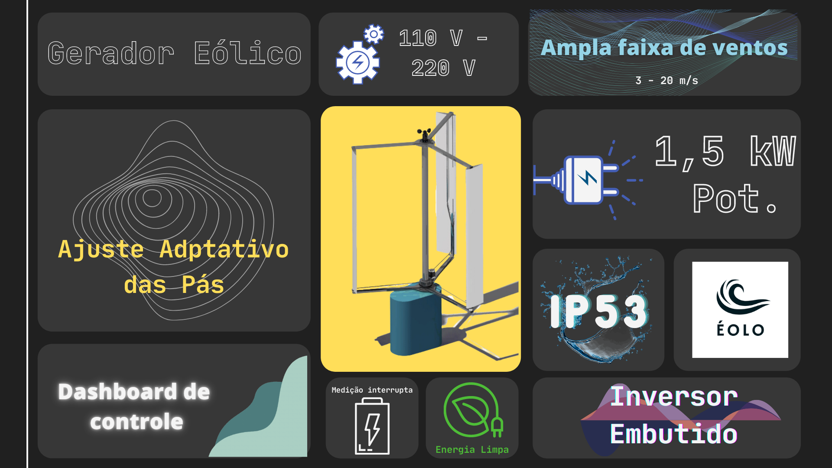
ÉOLO

Slide 27

Dúvidas?
Fim do PC3
CONTATO:
Telefone: (61) 9981-0903
Email: contato@eoloenergy.com

Slide 28
Fim PC3

Slide 29
150,000,000
Investment
Fifth in line from the Sun, Jupiter is, by far, the largest planet in the solar system – more than twice as massive as all the other planets combined

Slide 30

About Simple Pitch Deck
Do you know what helps you make your point clear? Lists like this one:
They’re simple
You can organize your ideas clearly
You’ll never forget to buy milk!
And the most important thing: the audience won’t miss the point of your presentation

Slide 31
Our competitors
 | Jupiter | Mars | Saturn
Feature 1 | Moon | Sun | Stars
Feature 2 | Galaxy | Diameter | Earth
Feature 3 | Pluto | Neptune | Mercury

Slide 32
150,000,000
Investment
Fifth in line from the Sun, Jupiter is, by far, the largest planet in the solar system – more than twice as massive as all the other planets combined

Slide 33
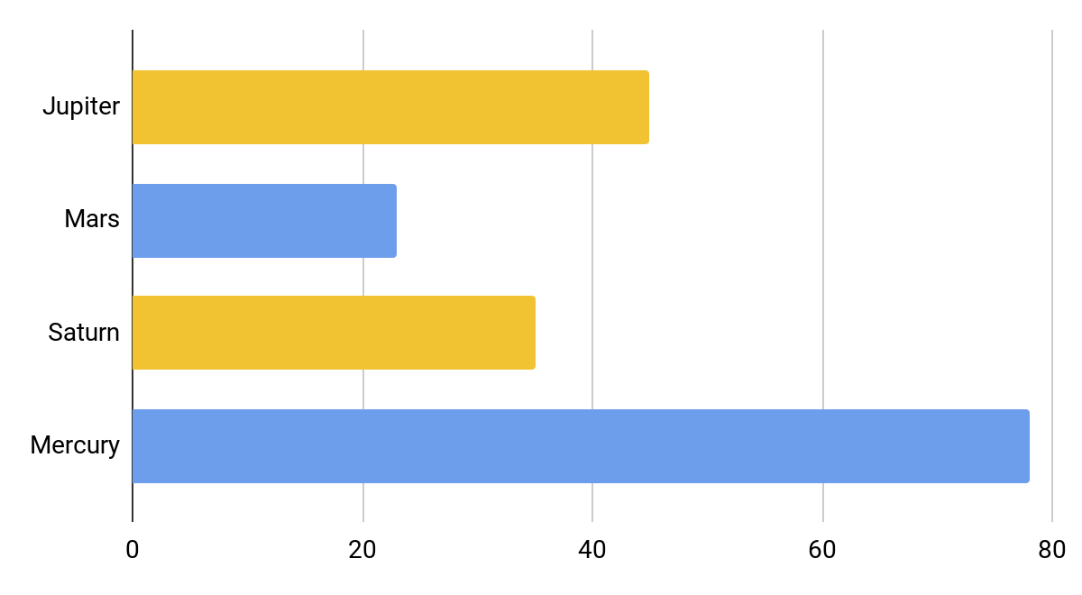
Market share
Follow the link in the graph to modify its data and then paste the new one here. For more info, click here

Slide 34

A picture is worth a thousand words

Slide 35
Our competitors
Jupiter
Saturn
Neptune
It’s the fifth planet from the sun and the largest in the system
It’s a gas giant with a radius of about nine times the Earth's
It’s the eighth and farthest-known planet from the sun
Mars
Venus
Mercury
It’s the fourth planet from the sun and it’s a cold place
Venus is a beautiful planet with extremely high temperatures
It’s the closest planet to the Sun and the smallest of them all

Slide 36
25%
34%
Statistics
67%
89%
It’s the fifth planet from the sun and the largest
Jupiter
It’s a gas giant and the only one with rings of them all
Saturn
It’s the eighth and farthest known solar planet
Neptune
It’s the closest planet to the Sun and the smallest
Mercury

Slide 37
Timeline
Jupiter
Neptune
It’s the fifth planet from the sun
It’s the farthest-known
01
02
03
04
Saturn
Mercury
It’s a gas giant with several rings
Mercury is the smallest planet

Slide 38
Our awards
Jupiter
Saturn
Neptune
It’s the fifth planet from the sun and the largest in the system
It’s a gas giant with a radius of about nine times the Earth's
It’s the eighth and farthest-known planet from the sun

Slide 39
Map
Jupiter
It’s the biggest planet of them all
Saturn
It’s a gas giant with rings
Neptune
It’s the eighth and farthest planet
Mercury
Mercury is the smallest planet

Slide 40


Our team
Jupiter
Saturn
It’s the fifth planet from the sun and the largest in the system
It’s a gas giant with a radius of about nine times the Earth's

Slide 41



Infographic
01
02
03
Jupiter
Saturn
Neptune
It’s the fifth planet from the sun
It’s a gas giant with several rings
It’s very far away from the Sun

Slide 42
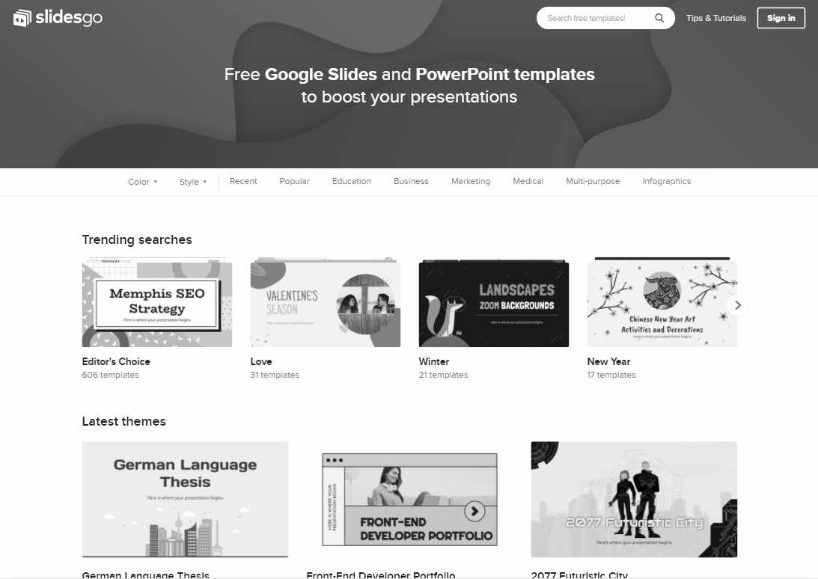
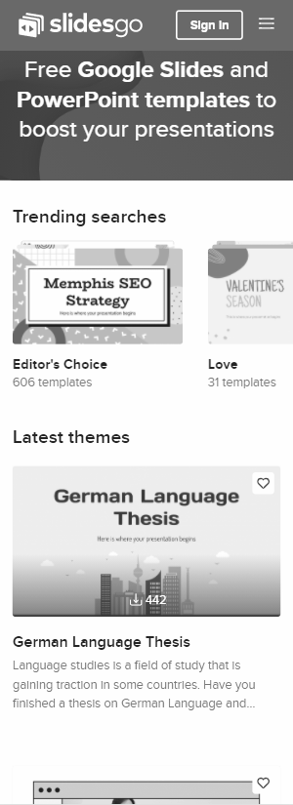
Find us here
You can replace the image on these screen with your own work. Just delete these ones, add yours and center them properly

Slide 43
SWOT analysis
S
W
Strengths
Weaknesses
Jupiter is the biggest planet of them all
Jupiter is the biggest planet of them all
O
T
Opportunities
Threats
Jupiter is the biggest planet of them all
Jupiter is the biggest planet of them all

Slide 44
SWOT analysis
S
W
Strengths
Weaknesses
Jupiter is the biggest planet of them all
Jupiter is the biggest planet of them all
O
T
Opportunities
Threats
Jupiter is the biggest planet of them all
Jupiter is the biggest planet of them all

Slide 45
Thanks!
Do you have any questions?
your-email@freepik.com
+91 620 421 838
yourcompany.com
Please keep this slide for attribution

Slide 46
Alternative resources

Slide 47
Alternative resources
You can also use this resources if you want
VECTORS:
Decorative europe map
Flat device mockup infographic
PHOTOS:
Man having a video call for work
Company colleague high five
Business people meeting at office working together
Medium shot people high fiving
Businesswomen working on a project together
Close up people at business meeting
Teamwork meeting with business people
Businesswoman working while her teammates are talking
Medium shot woman leading meeting indoor
Medium shot women in meeting

Slide 48
Resources
Find more illustration like these on Freepik
VECTORS:
Flat design colombia map infographic
Wifi background with connected electronic devices
PHOTOS:
Business people shaking hands
Medium shot women in business meeting
Side view of men handshaking in agreement after a meeting
People in business meeting high angle
Smiley businesswoman with glasses during a meeting presentation
Cheerful african american woman at table with gavel, books and statue
African american man sitting at the desk and smiles
Smiley colleagues in the office during a meeting
Medium shot smiley woman working
Front view of people having a meeting in the office

Slide 49
In order to use this template, you must credit Slidesgo by keeping the Thanks slide.
You are allowed to:
- Modify this template.
- Use it for both personal and commercial projects.
You are not allowed to:
- Sublicense, sell or rent any of Slidesgo Content (or a modified version of Slidesgo Content).
- Distribute Slidesgo Content unless it has been expressly authorized by Slidesgo.
- Include Slidesgo Content in an online or offline database or file.
- Offer Slidesgo templates (or modified versions of Slidesgo templates) for download.
- Acquire the copyright of Slidesgo Content.
For more information about editing slides, please read our FAQs or visit Slidesgo School:
https://slidesgo.com/faqs and https://slidesgo.com/slidesgo-school

Slide 50
Instructions for use (premium users)
In order to use this template, you must be a Premium user on Slidesgo.
You are allowed to:
Modify this template.
Use it for both personal and commercial purposes.
Hide or delete the “Thanks” slide and the mention to Slidesgo in the credits.
Share this template in an editable format with people who are not part of your team.
You are not allowed to:
Sublicense, sell or rent this Slidesgo Template (or a modified version of this Slidesgo Template).
Distribute this Slidesgo Template (or a modified version of this Slidesgo Template) or include it in a database or in any other product or service that offers downloadable images, icons or presentations that may be subject to distribution or resale.
Use any of the elements that are part of this Slidesgo Template in an isolated and separated way from this Template.
Register any of the elements that are part of this template as a trademark or logo, or register it as a work in an intellectual property registry or similar.
For more information about editing slides, please read our FAQs or visit Slidesgo School:
https://slidesgo.com/faqs and https://slidesgo.com/slidesgo-school

Slide 51
Fonts & colors used
This presentation has been made using the following fonts:
Fira Sans Extra Condensed
(https://fonts.google.com/specimen/Work+Sans)
Roboto
(https://fonts.google.com/specimen/Roboto)
#ffffff
#f1c232
#6d9eeb
#d8d8d8
#595959
#00000

Slide 52





Storyset
Create your Story with our illustrated concepts. Choose the style you like the most, edit its colors, pick the background and layers you want to show and bring them to life with the animator panel! It will boost your presentation. Check out How it Works.
Pana
Amico
Bro
Rafiki
Cuate

Slide 53
Use our editable graphic resources...
You can easily resize these resources without losing quality. To change the color, just ungroup the resource and click on the object you want to change. Then, click on the paint bucket and select the color you want. Group the resource again when you’re done. You can also look for more infographics on Slidesgo.

Slide 56
JANUARY
FEBRUARY
MARCH
APRIL
MAY
JUNE
PHASE 1
Task 1
Task 2
PHASE 2
Task 1
Task 2
JANUARY
FEBRUARY
MARCH
APRIL
PHASE 1
Task 1
Task 2

Slide 59
...and our sets of editable icons
You can resize these icons without losing quality.
You can change the stroke and fill color; just select the icon and click on the paint bucket/pen.
In Google Slides, you can also use Flaticon’s extension, allowing you to customize and add even more icons.

Slide 60
Educational Icons
Medical Icons

Slide 61
Business Icons
Teamwork Icons

Slide 62
Help & Support Icons
Avatar Icons

Slide 63
Creative Process Icons
Performing Arts Icons

Slide 64
Nature Icons

Slide 65
SEO & Marketing Icons

Slide 66


